Slide 1


Procedures for Amending
the Constitution
Pakistan Constitution 1973

Slide 2






Introduction
A Living Document
Orderly Change
Balanced Reform
A constitution is a "living document" that must adapt to changing realities.
Amendments ensure change is orderly, legal, and democratic.
The process preserves the fundamental structure while allowing for reform.
Legal Basis: Article 239
Page 2

Slide 3





Authority to Amend
Who Can Initiate?
Requirement
Only Parliament (National Assembly or Senate) has the power to initiate an amendment.
A bill must be passed by a 2/3 majority in both houses.
Who Cannot Amend?
Provincial assemblies and the President/PM cannot unilaterally amend the Constitution.
Constitution of Pakistan
Page 3

Slide 4






Amendment Process (Article 239)
Introduction
Voting
Assent
A bill is introduced in either the National Assembly or the Senate.
It must pass with a two-thirds supermajority of the total membership in both houses.
The bill is sent to the President for final approval (Assent).
Constitution of Pakistan
Page 4

Slide 5


Role of the President
Ordinary Legislation: The President can return a bill for reconsideration. If passed again, they must sign it.
Money Bills: The President cannot return money bills and must sign them.
Constitutional Amendments: Once passed by both houses with a supermajority, the President gives assent to make it law.
Constitution of Pakistan
Page 5

Slide 6

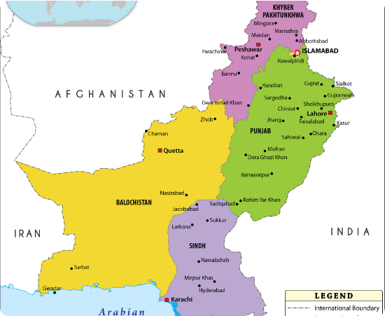

Amendments Affecting Provinces
Special Requirement
Trigger: If an amendment changes provincial boundaries or names.
Requirement: It must also be approved by the respective Provincial Assembly.
Vote Required: A 2/3 majority in that Provincial Assembly is required.
Constitution of Pakistan
Page 6

Slide 7

Important Amendments
Amend. | Year | Details
8th | 1985 | Legalized Martial Law acts; strengthened Presidential powers.
13th | 1997 | Removed Article 58(2)(b) (President's power to dissolve Assembly).
17th | 2003 | Legalized General Musharraf's rule.
18th | 2010 | Restored parliamentary democracy; granted provincial autonomy.
21st | 2015 | Established military courts for terrorism cases.
26th | 2024 | Judicial Reforms: Fixed Chief Justice tenure (3 yrs); Constitutional Benches.
27th | (Bill) | Proposed reforms for Local Governments and Military Courts.
Constitution of Pakistan
Page 7

Slide 8



Conclusion
Tool for Reform
Broad Consensus
Balanced System
Amendment powers are a tool for reform, not destruction.
The process requires broad political consensus (2/3 majority).
Pakistan's system balances rigidity (hard to change) with flexibility (ability to adapt).
Constitution of Pakistan
Page 8

Slide 9


Thank You For Your Time
ANY QUESTIONS?

